Slide 1
Physics 3 – Dec 3, 2019
P3 Challenge –
The current entering a 15.0  resistor is 3.78 A when connected to a battery. What is the current through a 25.0  resistor when it is connected to this same battery?

Slide 2
Objectives/Agenda/Assignment
Objective:
5.2 Circuits
Assignment:
Circuits worksheet
Agenda:
Circuit symbols
Drawing Circuits
Resistors in series and parallel
Measuring circuits
Kirchhoff’s Laws
Solving Circuits

Slide 3
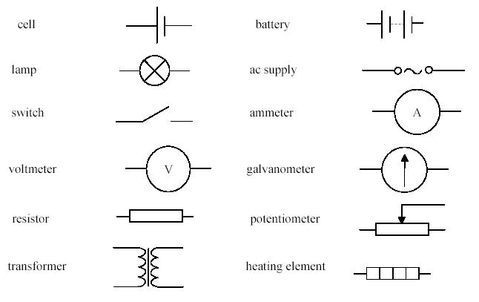
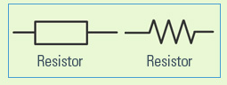
Electric Circuit Symbols
Wires are used to connect these elements and are
An alternate common symbol for a resistor is a zizag line:

Slide 4
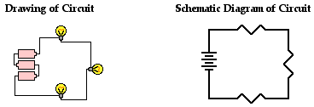
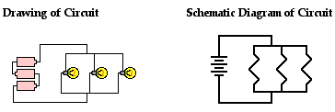
Drawing Circuits
Circuit diagrams are drawn using only horizontal and vertical lines to create boxes.
Two basic ways multiple items can be connected:
Series: all along one path
Parallel: each along its own path
Notice: The longer line on the cell represents a higher potential.

Slide 5
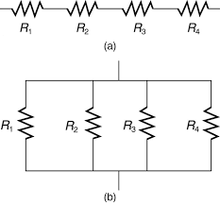
Resistors in Series
When multiple resistors are connected in series, they can be combined together and replaced by an equivalent total resistor.
The resistance of total resistor is the simple sum of the resistors connected in series.
R_{T} = R₁ + R₂ + R₃ + R₄
The current going through all resistors connected in series will be the same.

Slide 6
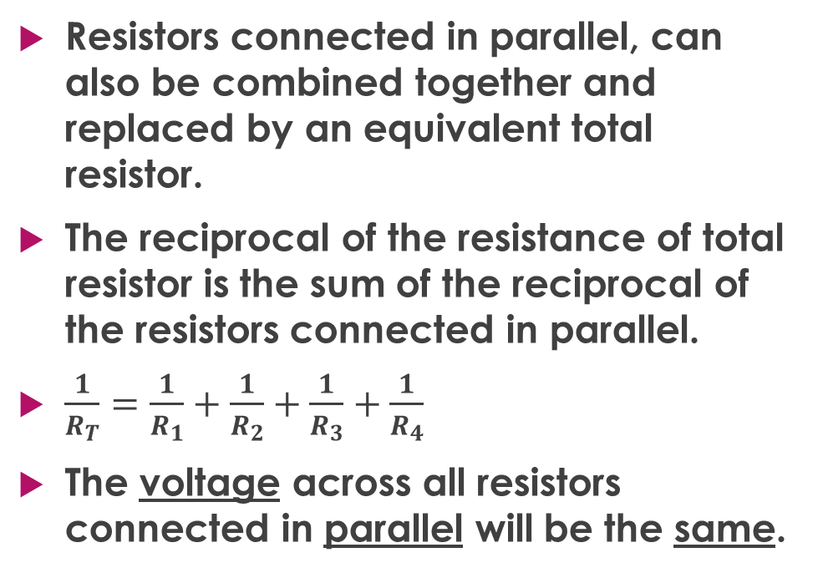
Resistors in Parallel
Resistors connected in parallel, can also be combined together and replaced by an equivalent total resistor.
The reciprocal of the resistance of total resistor is the sum of the reciprocal of the resistors connected in parallel.
$\frac{1}{R_{T}}=\frac{1}{R_{1}}+\frac{1}{R_{2}}+\frac{1}{R_{3}}+\frac{1}{R_{4}}$
The voltage across all resistors connected in parallel will be the same.

Slide 7
Measuring Circuits
An ammeter (galvanometer) is an instrument used to measure current.
Because current is constant in series, ammeters are placed in a circuit in series next to an element/wire you want to find the current for.
A voltmeter is an instrument used to measure potential/voltage.
Because potential is constant in parallel, voltmeters are placed in a circuit in parallel across an element you want to find the voltage for.

Slide 8
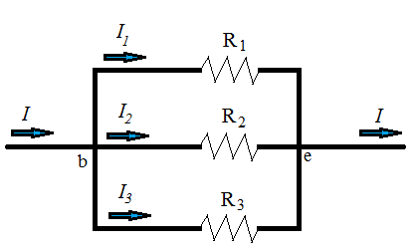
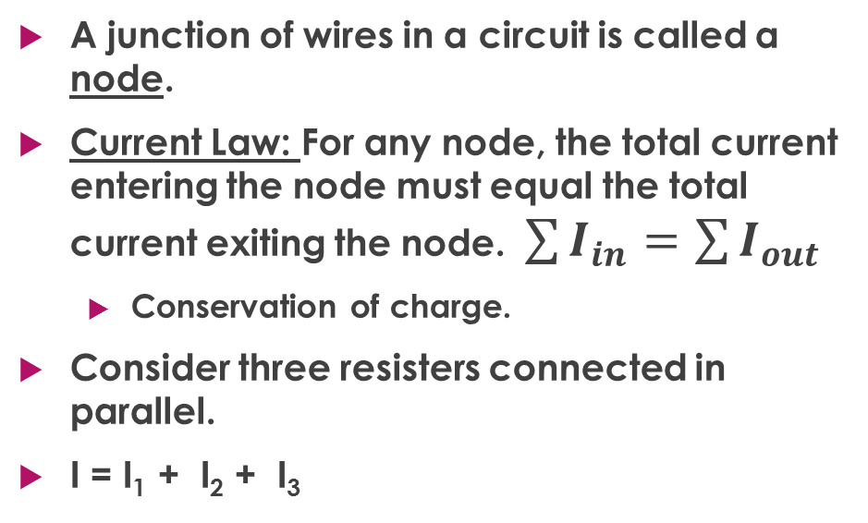
Kirchhoff’s Current Law
A junction of wires in a circuit is called a node.
Current Law: For any node, the total current entering the node must equal the total current exiting the node. $\sum{I_{in}=\sum{I_{out}}}$
Conservation of charge.
Consider three resisters connected in parallel.
I = I₁ + I₂ + I₃

Slide 9
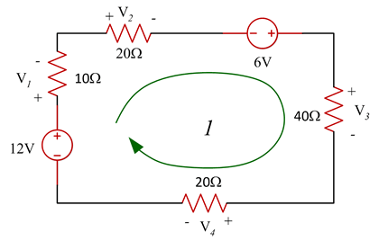
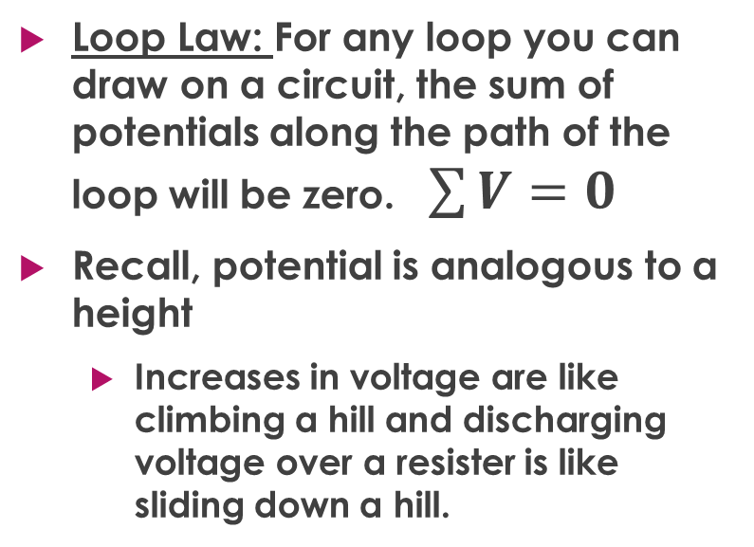
Kirchhoff’s Loop Law
Loop Law: For any loop you can draw on a circuit, the sum of potentials along the path of the loop will be zero. $\sum{V=0}$
Recall, potential is analogous to a height
Increases in voltage are like climbing a hill and discharging voltage over a resister is like sliding down a hill.

Slide 10
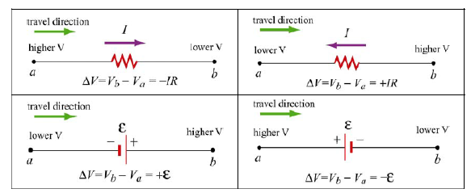
Sign conventions for the Loop law

Slide 11
Solving Circuits
Solving a circuit means to identify the current, potential, and resistance for each element shown.
It’s often convenient to organize given information and missing information to calculate within an Ohm’s law table:
Use Ohm’s Law, R_{T} calculations, and the Kirchhoff’s Laws as needed to complete the table.
Element | Potential , V = | Current , I x | Resistance, R
R₁
R₂
 Or R_{T}

Slide 12
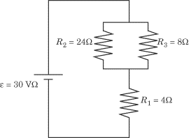
Sample problem
Strategy:
1) Determine number of different currents. Label on diagram.
2) Create an Ohm’s law table
3) Solve what you can using Loop rule, Current rule, Ohm’s law or methods to find total resistances.

Slide 13
Exit slip and homework
Exit Slip – A 6  Resistor and a 4  Resistor are connected to a 12V power source in series. Sketch and solve the resulting circuit.
What’s due? (homework for a homework check next class)
Circuits Worksheet
What’s next? (What to read to prepare for the next class)
Read 5.3 p 227-231

